Slide 1


<Bryan Montalvo Ramos>
<10/17/2023>

Slide 2

Outline
Executive Summary
Introduction
Methodology
Results
Conclusion
Appendix

Slide 3
Executive Summary
Summary of methodologies
We used 4 different Methods which where logistic regression, support Vector Machine, K nearest Neighbors and decision tree classifier to analyze our data.
Summary of all results
Results came out very close most being 83.3% accuracy rate for predicted landings.

Slide 4
Introduction
The project deals with the Space X program, and how much each launch will cost given that the stage 1 Rocket is re-usable. The biggest hurdle is to train this Machine learning model to predict Successful Landing to predict the cost of each launch.

Slide 5

Section 1

Slide 6
Methodology
Executive Summary
Data collection methodology: We used an API and web scrapping Wiki pages to gather all the information.
Perform data wrangling to fill in the missing values as much as possible and classify the 8Result as successful or un-successful landing.
Perform exploratory data analysis (EDA) using visualization and SQL
Perform interactive visual analytics using Folium and Plotly Dash
Perform predictive analysis using classification models
Tuned Models using GridSearchCV for better accuracy.

Slide 7
Data Collection
Data was collected by using a combination of the API and web scrapping from various wiki pages that held Space X data.

Slide 8
Data Collection – SpaceX API
Request
JSON file
Lists
Cast defined relevant data into DF
Json_normalize into a Dataframe
Filter data for only Falcon 9 Launches
https://github.com/bmontalvo12921/Capstone-project/blob/main/jupyter-labs-spacex-data-collection-api%20(2).ipynb
Define relevant data
Fill in Missing values from PayloadMass Values

Slide 9
Data Collection - Scraping
https://github.com/bmontalvo12921/Capstone-project/blob/main/jupyter-labs-webscraping%20(1).ipynb
Request from HTML
Define relevant data
Beautiful Soup
H tml5lib Parser
Cast relevant data into DF
Finch html tables

Slide 10
Data Wrangling
For Data wrangling we compiled the data that we had gathered from both API and Web scrapping into usable data-frames which we can manipulate to further our understanding and train the machine learning Model.
https://github.com/bmontalvo12921/Capstone-project/blob/main/labs-jupyter-spacex-Data%20wrangling.ipynb

Slide 11
EDA with Data Visualization
We used different charts such as scatter plots, Bar graphs, and Line graphs to give us a better picture of how the data changes through different variables.
https://github.com/bmontalvo12921/Capstone-project/blob/main/jupyter-labs-webscraping%20(1).ipynba

Slide 12
EDA with SQL
Using SQL we were able to extract key information from the tables gained during the data collection process. The Data includes the following: distinct launch location, distinct Booster models, Payload mass(kg), and finally the outcomes of each test.
https://github.com/bmontalvo12921/Capstone-project/blob/main/jupyter-labs-eda-sql-coursera_sqllite-bak-2023-10-18-00-50-37Z.ipynb

Slide 13
Build an Interactive Map with Folium
We created an Interactive map highlighting the different launch sites and the successful launch that occurred with each launch site.
Explain why you added those objects
https://github.com/bmontalvo12921/Capstone-project/blob/main/jupyter-labs-eda-sql-coursera_sqllite-bak-2023-10-18-00-50-37Z.ipynb

Slide 14
Build a Dashboard with Plotly Dash
The Plotly Dash was created to display the data in two forms. One is the pie graph which breaks down the successful launches by percentage bringing them together as a whole. And the bottom graph is a scatter plot divided into two categories to show successful or unsuccessful launches carried out. We also added a dropdown menu which helps isolate the data to a specific launch site.
https://github.com/bmontalvo12921/Capstone-project/blob/main/spacex_dash_app.py

Slide 15
Predictive Analysis (Classification)
The predictive analysis is the Machine learning Model that we train to better predict the launch outcomes to calculate the cost per launch. I believe we need more data as the results I have seem skewed.
https://github.com/bmontalvo12921/Capstone-project/blob/main/IBM-DS0321EN-SkillsNetwork_labs_module_4_SpaceX_Machine_Learning_Prediction_Part_5.jupyterlite%20(1).ipynb

Slide 16
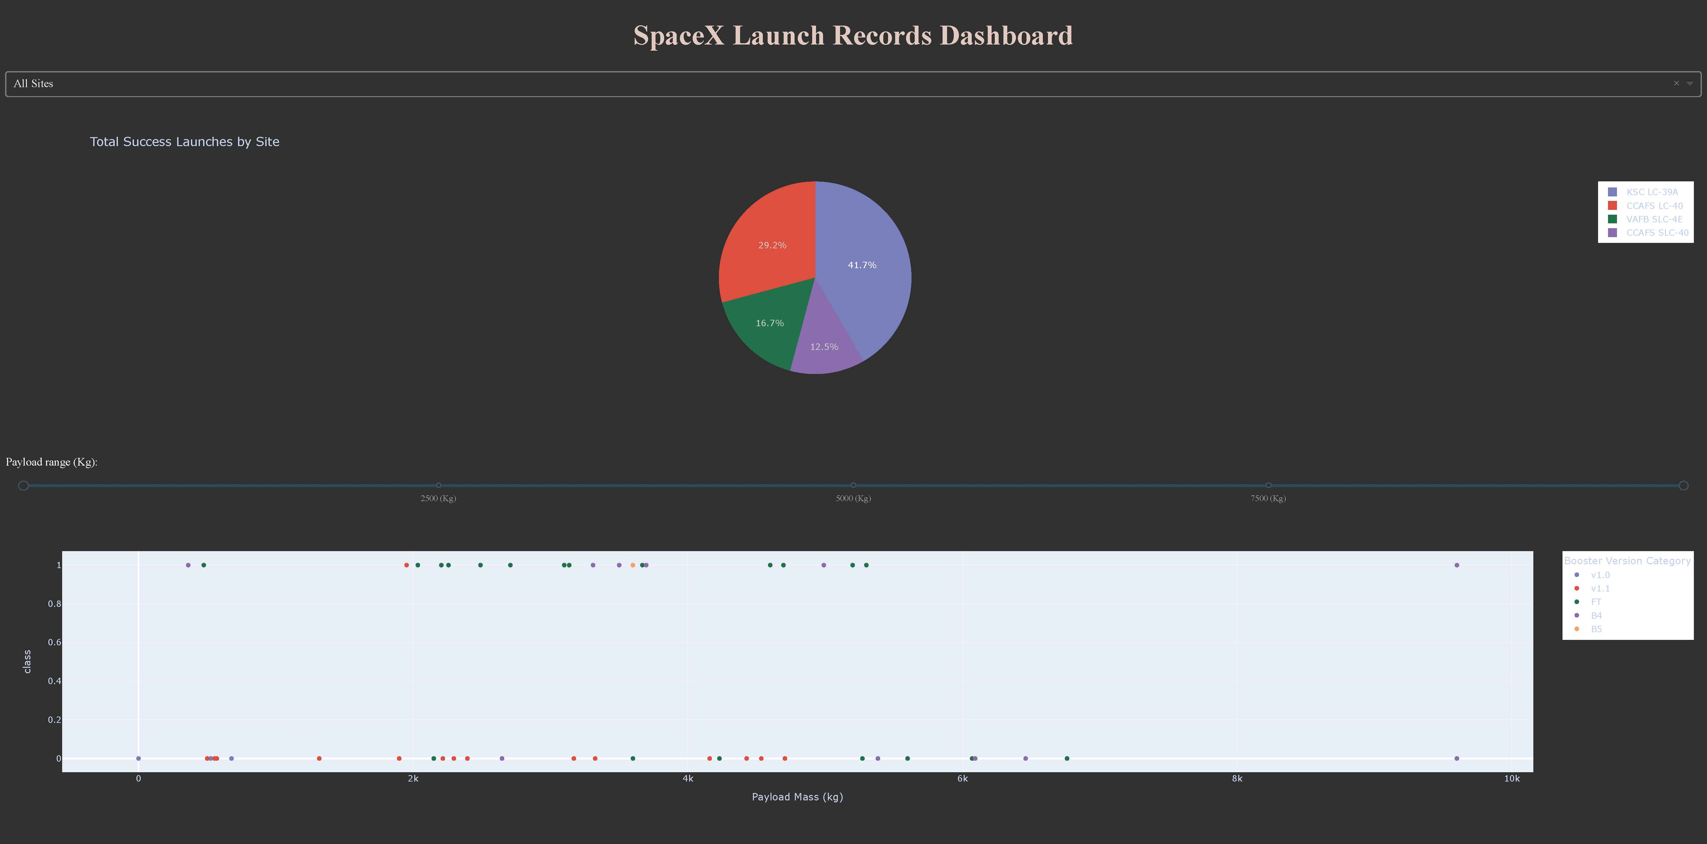
Results
Exploratory data analysis results
We achieved 83.3% accuracy rate.

Slide 17

Section 2

Slide 18
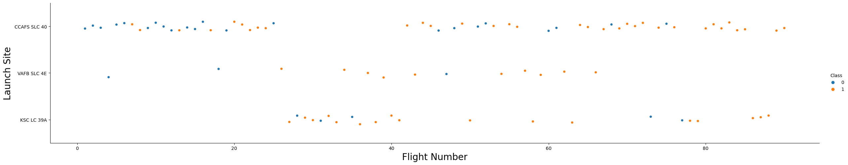
Flight Number vs. Launch Site
Flight Number vs. Launch Site
This is a scatter plot with the number of the flight from each site and the breakdown via color on whether those flights were successful or not.

Slide 19
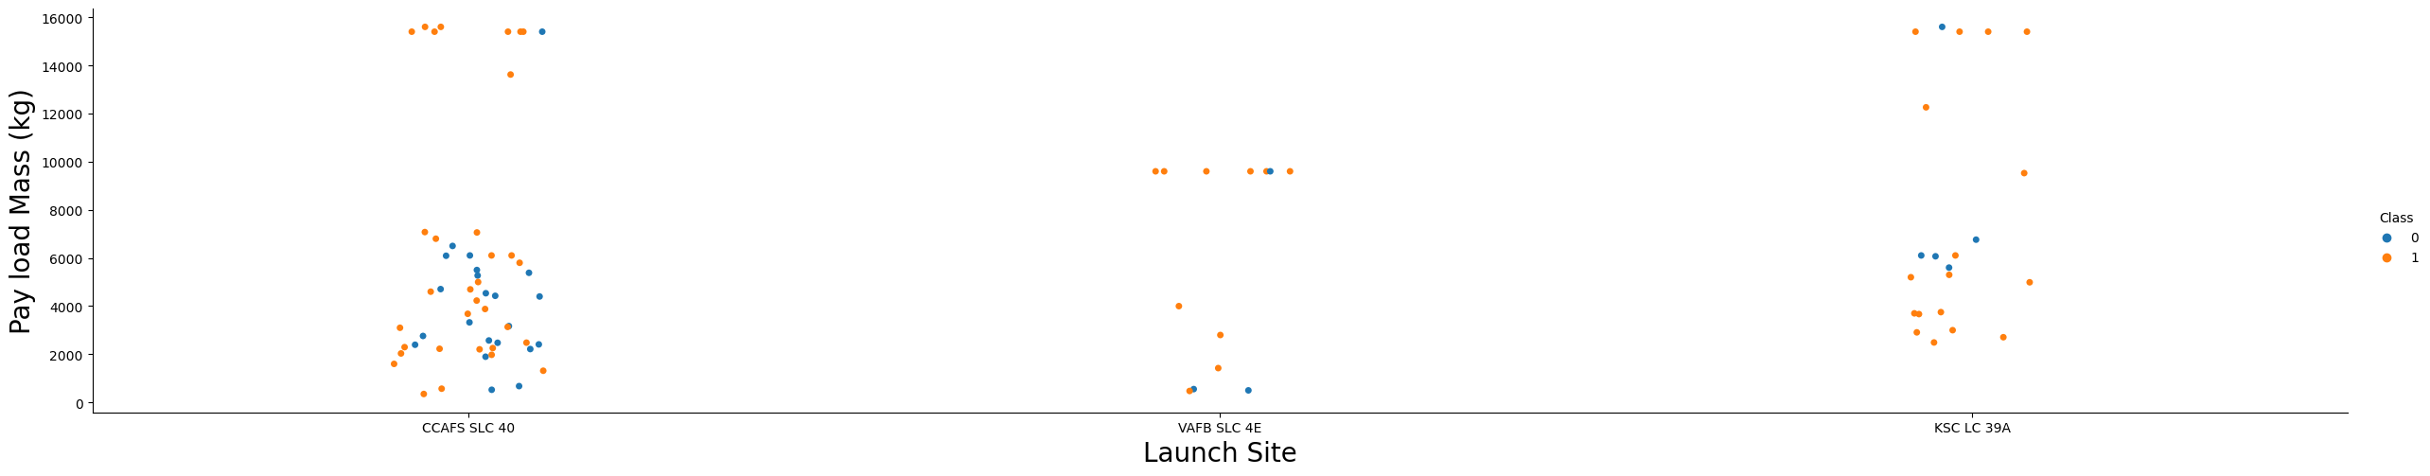
Payload vs. Launch Site
Show a scatter plot of Payload vs. Launch Site
This a scatter plot where the flight numbers are split into sites and the categories via color to show outcome.

Slide 20
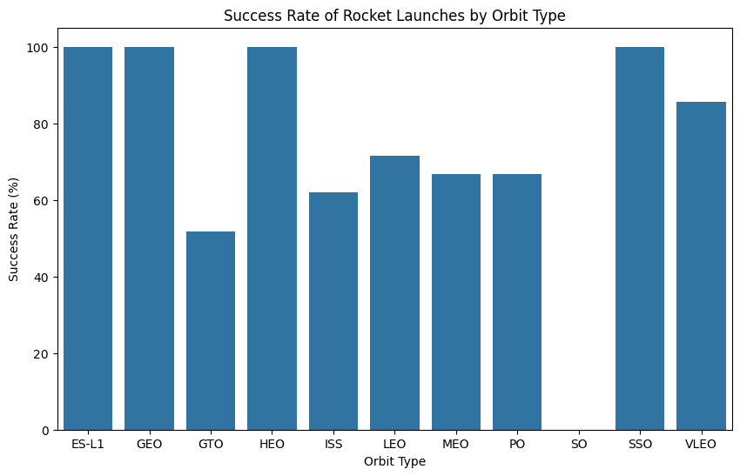
Success Rate vs. Orbit Type
Show a bar chart for the success rate of each orbit type
This Bar graph shows the success rate of each Orbit after successful launch.

Slide 21
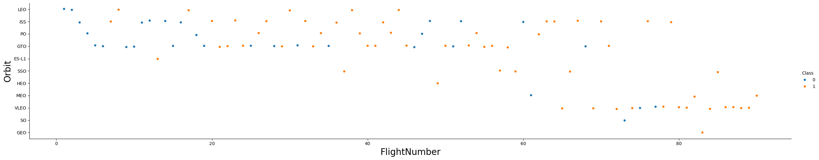
Flight Number vs. Orbit Type
Show a scatter point of Flight number vs. Orbit type
This scatter plot displays the different results in the Orbit type according to the flight number. The graph is broken down by color category which is successful or unsuccessful.

Slide 22
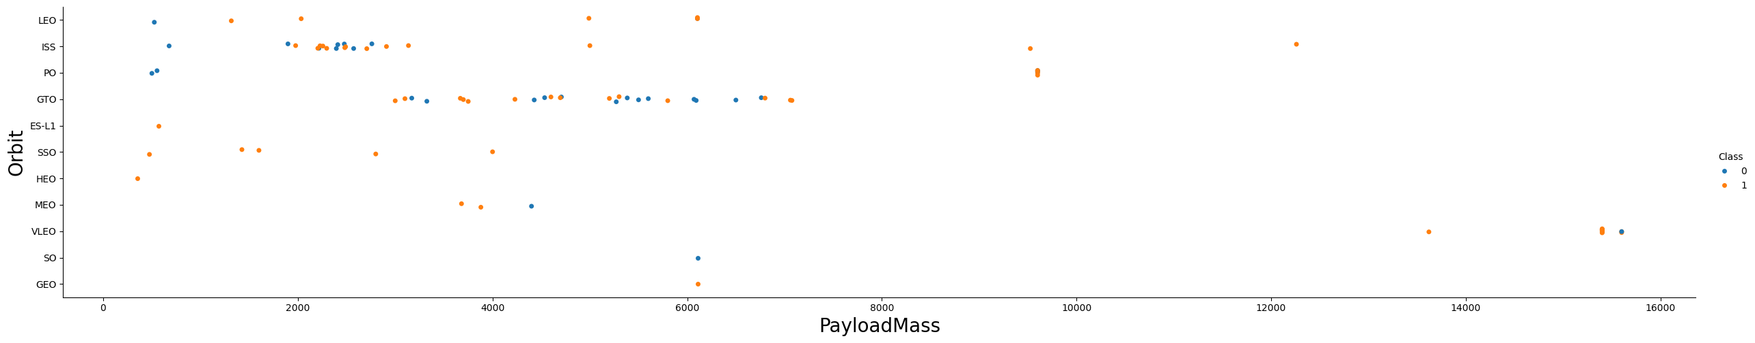
Payload vs. Orbit Type
Show a scatter point of payload vs. orbit type
This scatterplot displays the different outcomes for each orbit in relation to the payload mass.

Slide 23
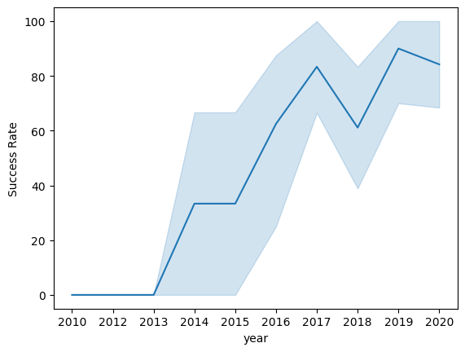
Launch Success Yearly Trend
This line graph shows the progress achieved in success rate over 10-year span.

Slide 24
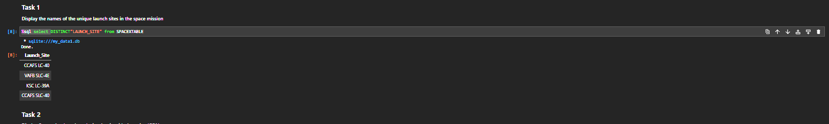
All Launch Site Names
Launch_Site
CCAFS LC-40
VAFB SLC-4E
KSC LC-39A
CCAFS SLC-40
Find the names of the unique launch sites
The query states Select Distinct “Launch_Site” from Spacextable

Slide 25
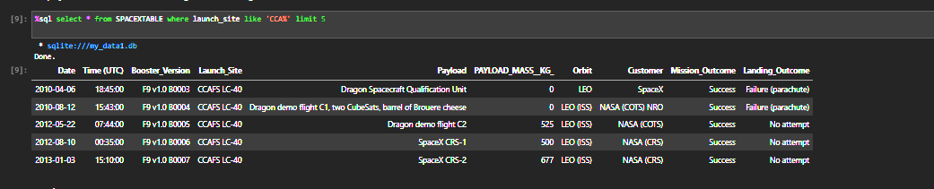
Launch Site Names Begin with 'CCA'
Find 5 records where launch sites begin with `CCA`
The Query states Select * from spacextable where Launch_site like’CCA%’ limit 5.

Slide 26
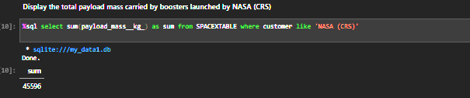
Total Payload Mass
Calculate the total payload carried by boosters from NASA
This Query is a two-step process in which it is adding quantities and creating a new column representing the value.

Slide 27
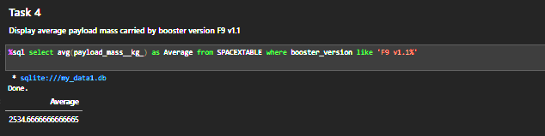
Average Payload Mass by F9 v1.1
Calculate the average payload mass carried by booster version F9 v1.1
This query is the same as above where it does an equation and creates a new column displaying the new float.

Slide 28
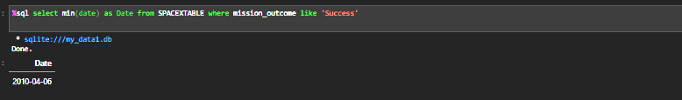
First Successful Ground Landing Date
Find the dates of the first successful landing outcome on the ground pad
This query selects the first successful launch date.

Slide 29
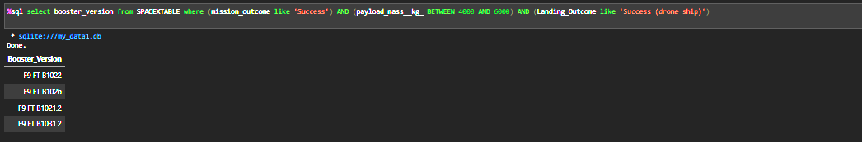
Successful Drone Ship Landing with Payload between 4000 and 6000
List the names of boosters that have successfully landed on drone ship and had payload mass greater than 4000 but less than 6000

Slide 30
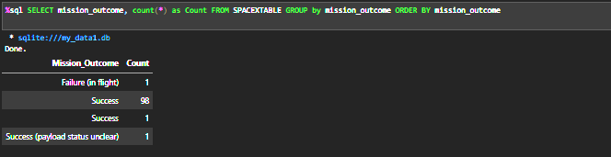
Total Number of Successful and Failure Mission Outcomes
Calculate the total number of successful and failure mission outcomes
Query creates a table with the required information

Slide 31
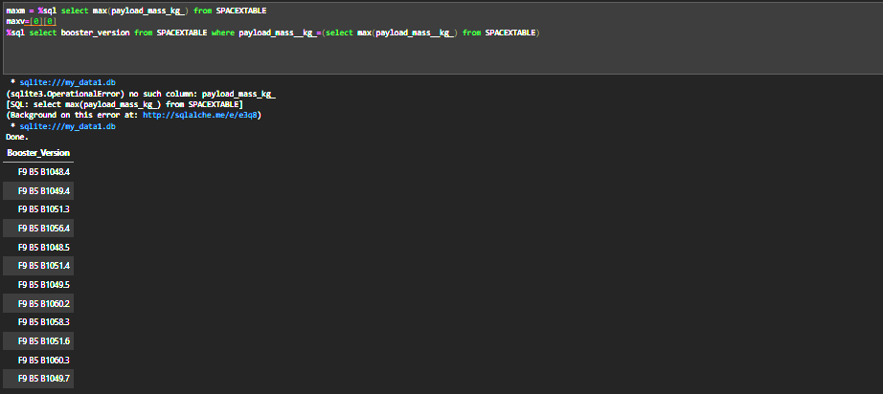
Boosters Carried Maximum Payload
List the names of the booster which have carried the maximum payload mass
Query present the different version of the Boosters.

Slide 32
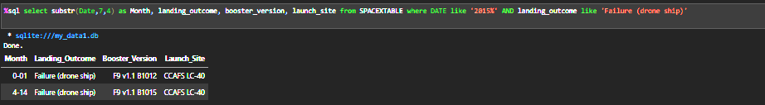
2015 Launch Records
List the failed landing_outcomes in drone ship, their booster versions, and launch site names for in year 2015
Queries the Failure to land outcomes in the year 2015.

Slide 33
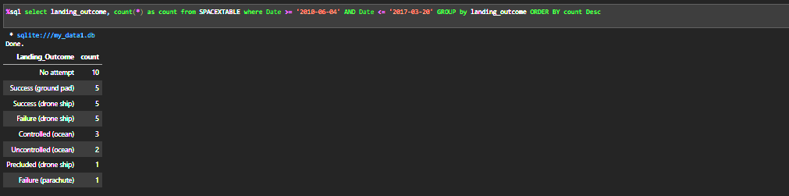
Rank Landing Outcomes Between 2010-06-04 and 2017-03-20
Rank the count of landing outcomes (such as Failure (drone ship) or Success (ground pad)) between the date 2010-06-04 and 2017-03-20, in descending order
Present your query result with a short explanation here

Slide 34

Section 3

Slide 35
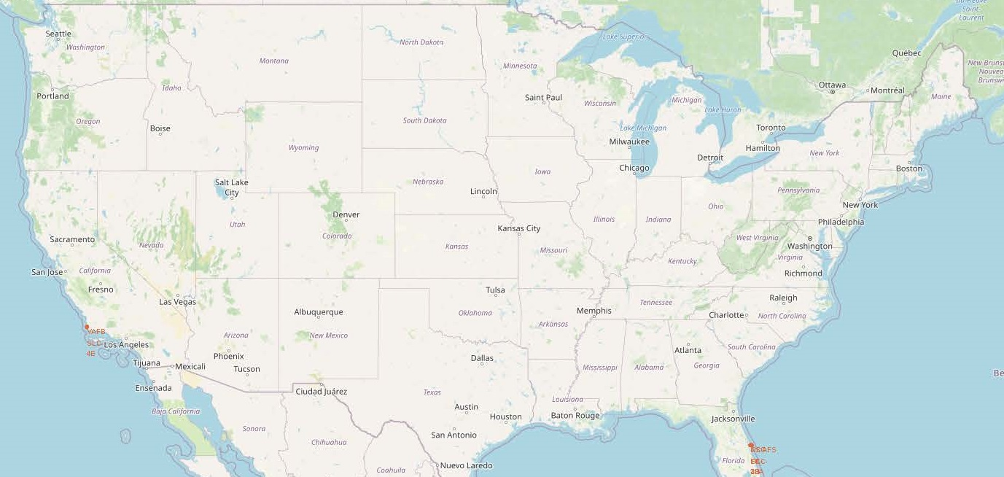
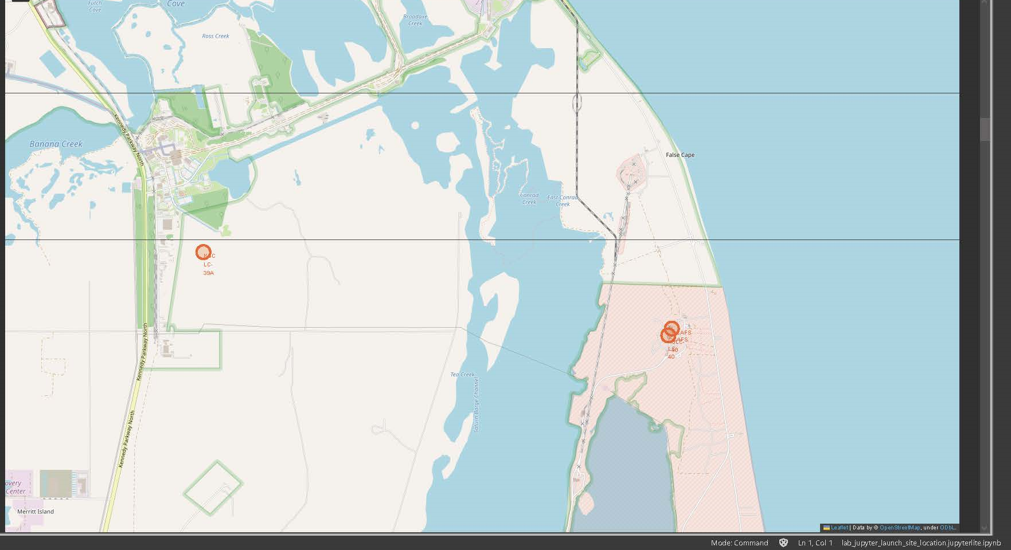
Launch Location Sites
The Folium map above shows the different highlighted launch sites in the United States.

Slide 36

Section 4

Slide 37
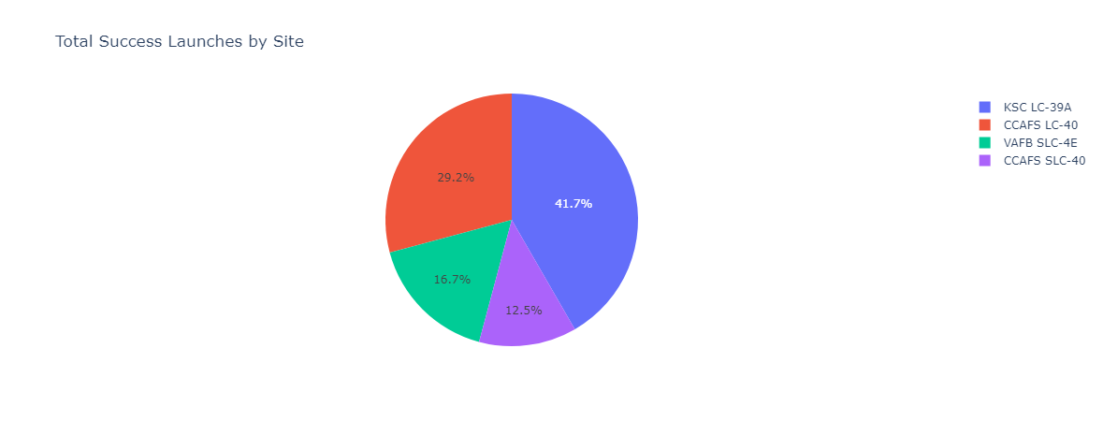
<Successful Launches for all Sites>
The Legend explains the break down by color of the different sites and their success rates.

Slide 38
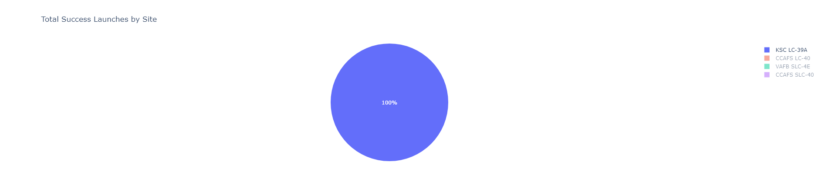
<Site with Highest Success Rate>
The Pie Chart shows that this Particular site (KSC LC-39A) had a 100% success rate.

Slide 39
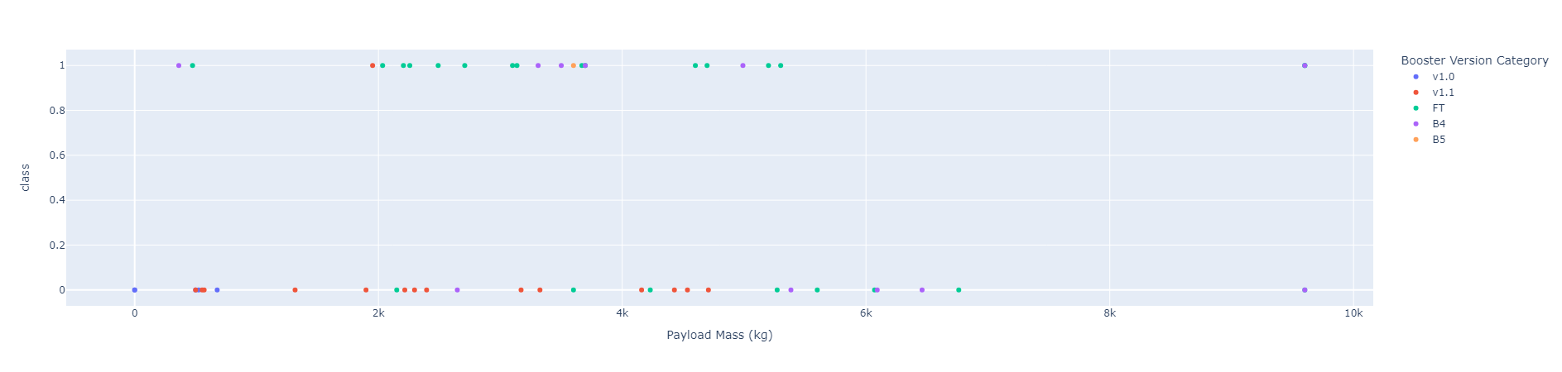
<All PayLoad Mass/ Success Rates>
This is the Scatter plot comparing payload and Booster success rates.
The Boosters are broken down by Color and then categories between 0(Failed Launch) or 1(Successful Launch). Booster Version FT has the most successful Launches.

Slide 40

Section 5

Slide 41
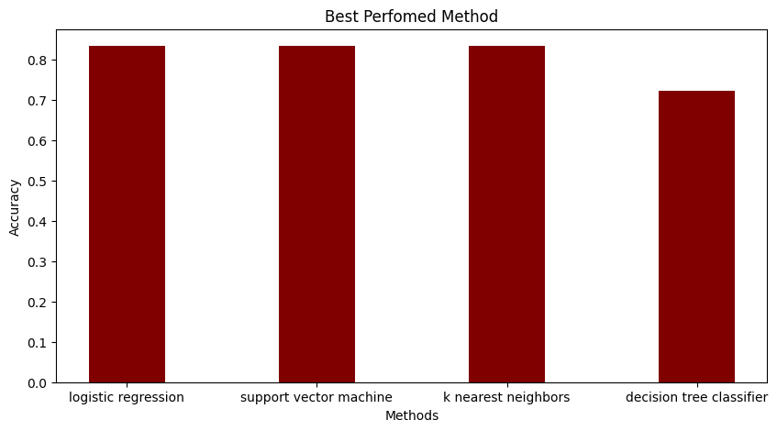
Classification Accuracy
Visualize the built model accuracy for all built classification models, in a bar chart
The Logistic regression and Support Vector Machine and K nearest neighbor all came in 83% accuracy rate.

Slide 42

Confusion Matrix
Show the confusion matrix of the best-performing model with an explanation
The best Performing Model is where 12 landed, worse would be where no one landed.

Slide 43
Conclusions
After using all Methods and procedures available to me, I have come to the conclusion that we need more data. This will allow us to make a better prediction model which would allow us to make better decisions on what kind of technological advances we can make to bring the cost of Space travel down a significant amount.

Slide 44


